Slide 1

Final Presentation CST2205-Data Modeling
Order and Sales Management
Arit Akpan
Eduardo Manotas
Julia Saaverda
Lillian Townley
Esin Bilgin Savkli
01/04/2024

Slide 2

Agenda
Introduction
Define Problem Statement and Objective​
Data modeling in Power BI
Storytelling though dashboards
Key Outcomes

Slide 3
Introduction
Company Review
HappyCo is a fictional e-commerce platform
With a commitment to delivering exceptional value and convenience to its customers
Central to HappyCo's success
Its strategic focus on optimizing digital operations
Sales Management
Order Processing
Shipment Monitoring
Employee Performance Review
Inventory Management

Slide 4
Objective and Problem Statement
Objective
HappyCo's objective is to grow its market position and increase sales in the competitive e-commerce sector.
Problem Statement
HappyCo faces the challenge of analyzing its performance over the past three years to identify what's working,
what needs improvement, and where new opportunities for growth lie.
The goal is to use these insights to enhance operational efficiency and customer satisfaction, thereby boosting
sales and ensuring the company's long-term success in the online marketplace.

Slide 5
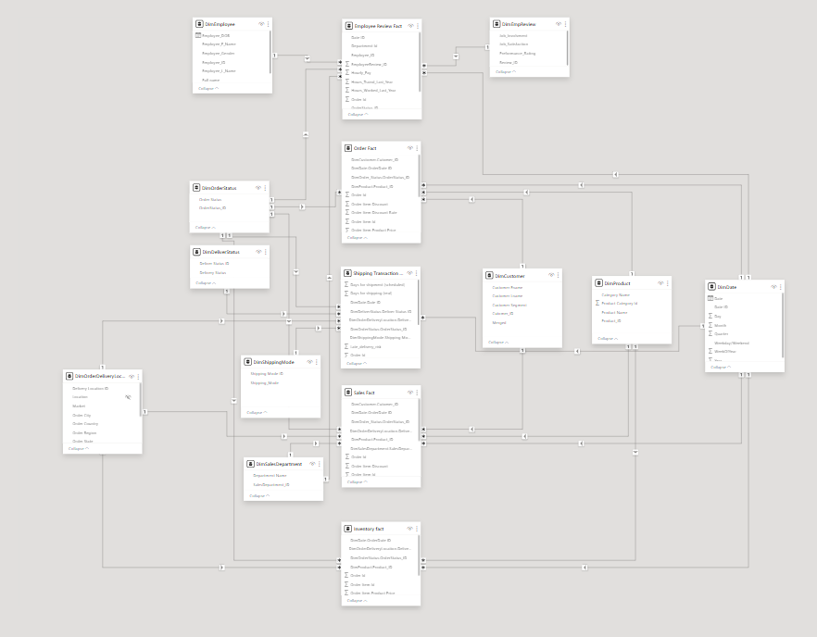
Data Modeling in Power BI
The dataset was clean and ready to use
Particularly enriched with employee data
Allowed us to create five specialized
business process data models
Dataset link:
https://www.kaggle.com/datasets/shashwatwork/dataco-smart-supply-chain-for-big-data-analysis

Slide 6
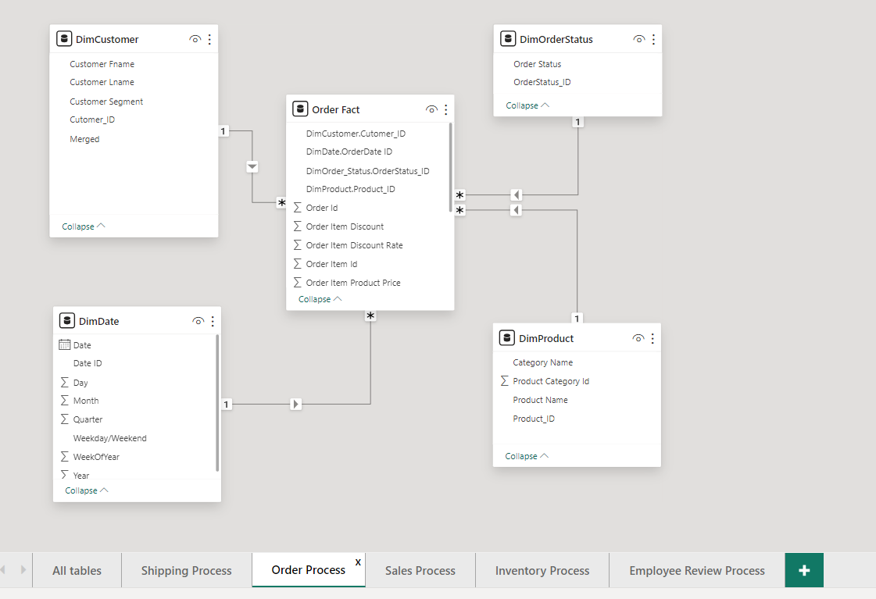
Best Practices
Bus matrix served as a blueprint for our models
Within Power BI, we meticulously organized our models and reports to ensure ease of use and clarity.
We employed conformed dimensions across the models
Business Process/Dimensions​ | Employee Information​ | Date​ | Order Status​ | Review​ | Department​ | Customer​ | Product​ | Shipping Mode​ | Delivery Status​ | Delivered Location​
Employee Process​ | X​ | X​ | X​ | X​ | ​ | ​ | ​ | ​ | ​ | ​
Order Process​ | ​ | X​ | X​ | ​ | ​ | X​ | X​ | ​ | ​ | ​
Shipping Process​ | ​ | X​ | X​ | ​ | ​ | ​ | ​ | X​ | X​ | X​
Sales Process​ | ​ | X​ | X​ | ​ | X​ | X​ | X​ | ​ | ​ | X​
Inventory Process​ | ​ | X​ | X​ | ​ | ​ | ​ | X​ | ​ | ​ | X​

Slide 7
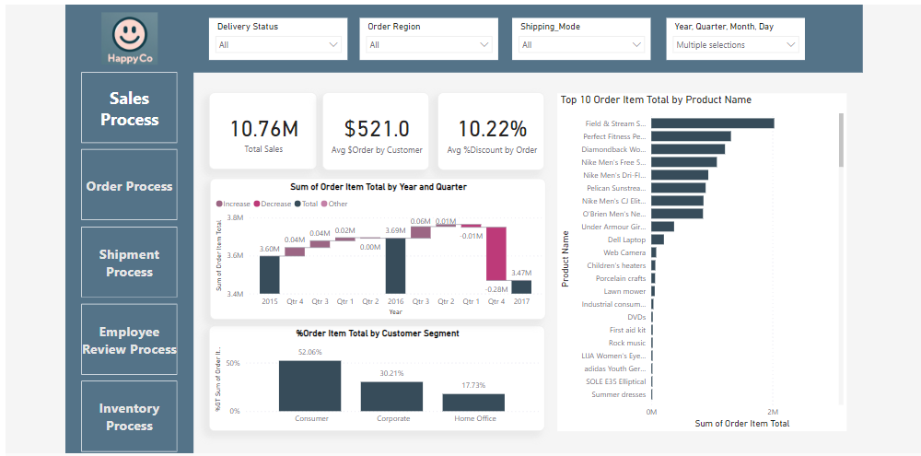
Storytelling though dashboard

Slide 8
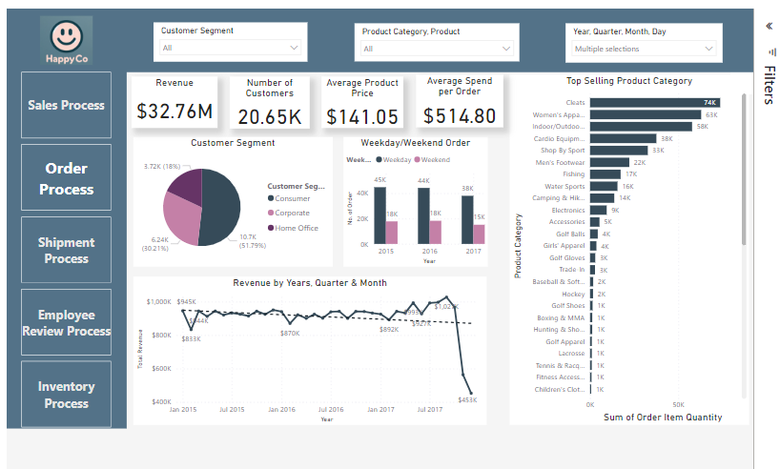
Storytelling though dashboard
Customers – Loyal customer are steady over the years. 3 customer Segments ​
​
Company serves low-income to middle class earners​
​
Product Category – Top 3 sellers: Cleats, Men's footwear, Women Apparel​
​
Revenue – Mostly steady until 4th quarter 2017 where there was a decline due to products being out of stock​

Slide 9
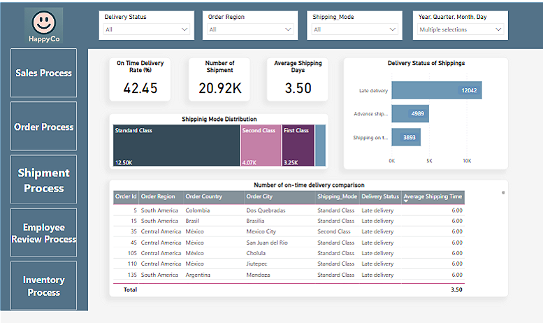
Storytelling though dashboard
For the last three years, ​
​
57% of deliveries are late delivery and most are standard class shipping. ​
Focusing on these deliveries to increase customer satisfaction and increase our sales.

Slide 10
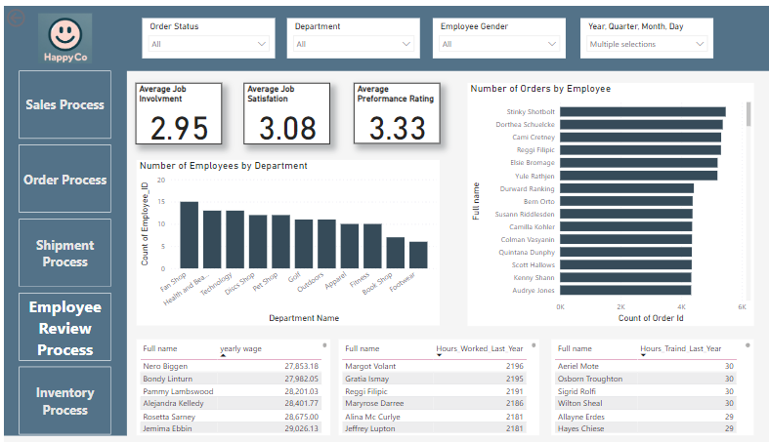
Storytelling though dashboard
When we filter the data we can see that all of the top-performing employees are from the Fan Shop Department and Footwear Department. This shows that these employees maybe overworked and moving employees from other departments or hiring new employees would be good for sales.​
​

Slide 11
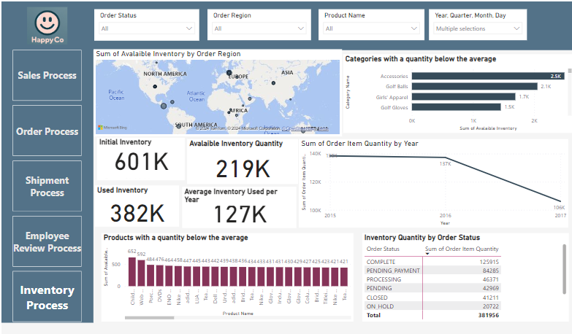
Storytelling though dashboard
The company started with 601,000 units of inventory across 50 categories and 118 products.
Over the years 2015 to 2017, it sold or committed 382,000 units, averaging 127,000 units per year.
The dashboard shows categories and products below average stock, like Accessories and Children's Heaters, needing more attention to avoid shortages

Slide 12
Outcomes
Outcomes from data analysis
Expand our top selling category
Diversify market sales using new SKUS
Expand customer database in pacific region
Improve on-time delivery for customer satisfaction
Align inventory based on business trend
Learning from project
Learned how to integrate theory material learned in class into practice
Creating bus matrix
Identifying and implementing of conformed dimensions
How to create star schema and unify them

Slide 13
THANK YOU

